Slide 1

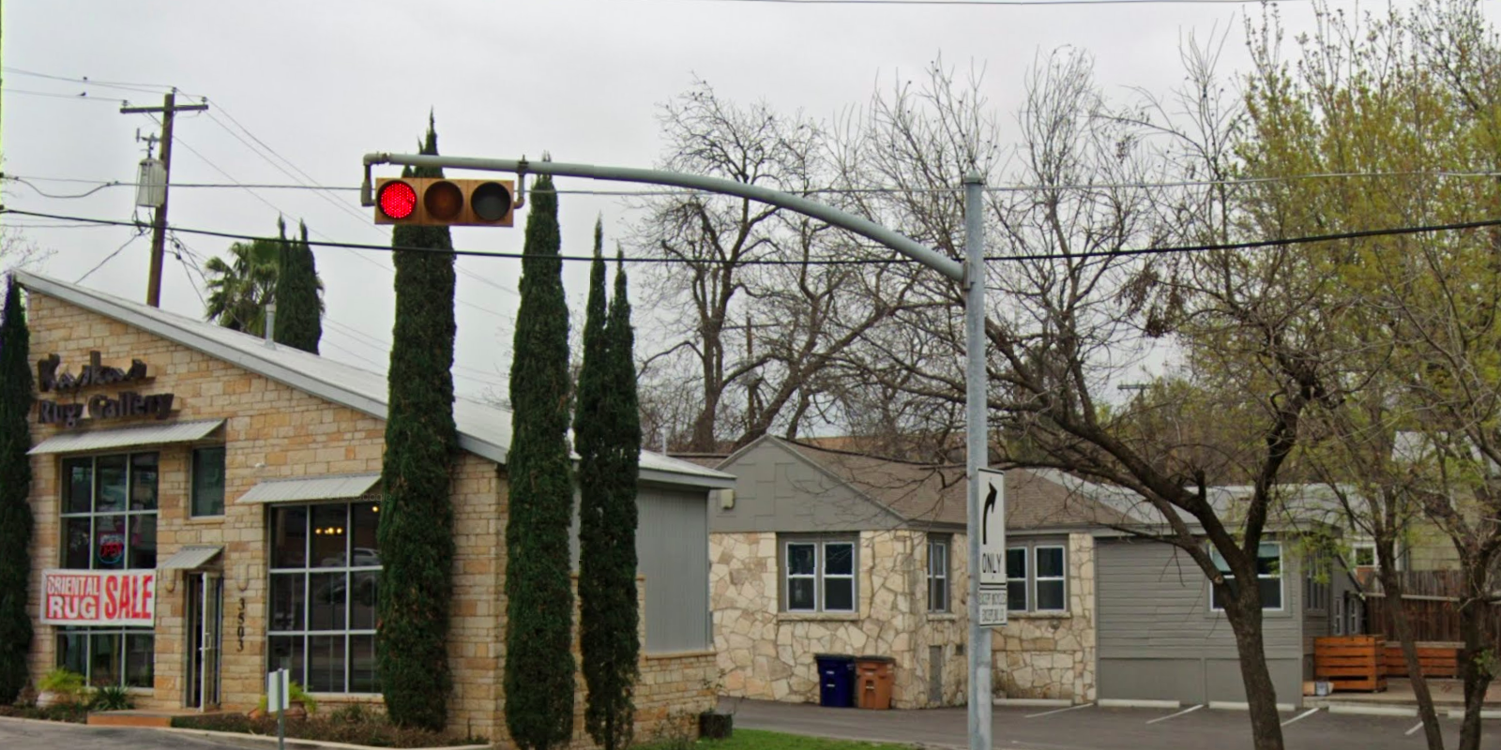
Austin Transportation Department Signs Work Orders
Created By: Susanne Gov Created Date: 2020-05-21 Location Name: 35TH ST / KERBEY LN Intersection ID: 5155597 Cardinal Direction: N
Sign Type | Install/Remove
No Left Turn Arrow | Install

Slide 2
Austin Transportation Department Signs Work Orders
Created By: Susanne Gov Created Date: 2020-05-21 Location Name: 35TH ST / KERBEY LN Intersection ID: 5155597 Cardinal Direction: S
Sign Type | Install/Remove

Slide 3
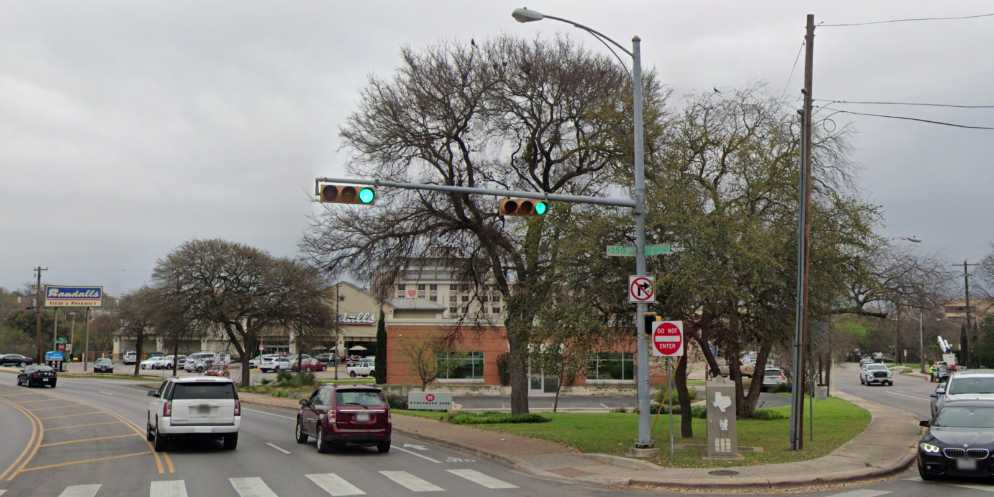
Austin Transportation Department Signs Work Orders
Created By: Susanne Gov Created Date: 2020-05-21 Location Name: 35TH ST / KERBEY LN Intersection ID: 5155597 Cardinal Direction: E
Sign Type | Install/Remove
No Right Turn Arrow | Install
Street Name Sign | Install

Slide 4
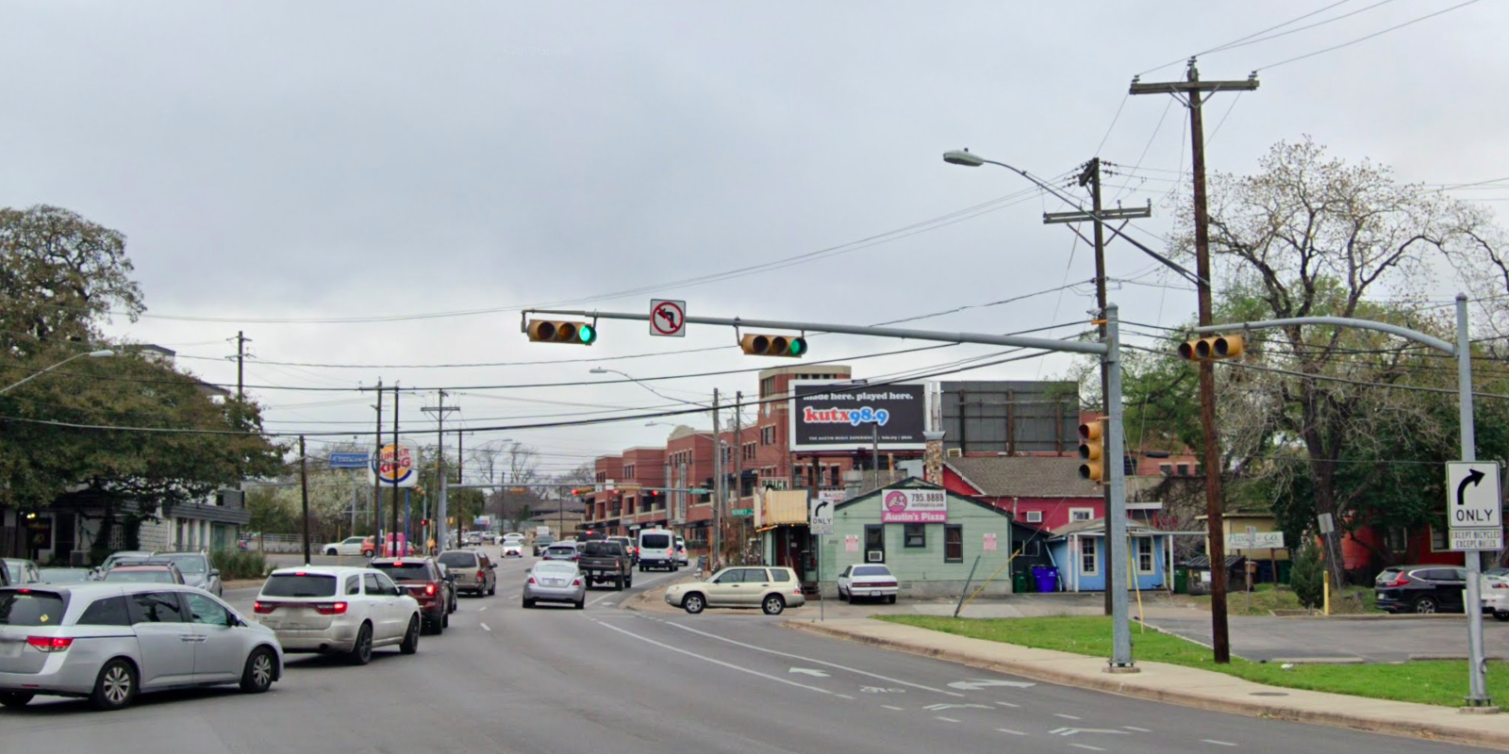
Austin Transportation Department Signs Work Orders
Created By: Susanne Gov Created Date: 2020-05-21 Location Name: 35TH ST / KERBEY LN Intersection ID: 5155597 Cardinal Direction: W
Sign Type | Install/Remove

